Slide 1
SATELLITE DRIVEN WILDFIRE IMPACT ANALYSIS
SHASHANK SHIVAKOTI
23103084
M. S. c. Data Science Student
University of Hertfordshire
Github link: https://github.com/shashank08-spec/Ds-project/blob/main/DSS_Final.ipynb

Slide 2
Introduction
Motivation:
For a data science student or professional, this dataset provides an opportunity to work with big real-world data, including tasks like cleaning data, handling geospatial information, and working with time-series data. It also allows for using advanced modeling techniques and data visualization tools, as well as presenting findings in a way that's clear and useful for people who aren't experts in the field.
Research question:
What are the most common causes of wildfires (human, lightning, etc.)?

Slide 3
Overview if previous work related to the project
Title: Spatial wildfire occurrence data for the United States, 1992–2015
What they did :Created the official FPA-FOD dataset that's part of the Kaggle wildfire data set. Looked at long-term trends in US wildfires based on size, cause, and location.
Relevance to your project: This study forms the basis of the dataset you're using . Your project uses their original data and adds machine learning predictions on top of it.
Title: Quantifying the effects of environmental factors on wildfire burned area
What they did:Used machine learning regression models to examine how environmental factors like temperature, humidity, and wind influence the size of wildfires.
Relevance:You can compare your machine learning approach, such as XGBoost, with their environmental prediction models.

Slide 4
Title: Wildfire assessment using machine learning algorithms in different regions
What they did : Used machine learning classification models like Random Forest and Decision Trees to categorize wildfire severity.
Relevance : This is similar to your project’s use of ML classification for predicting wildfire size and cause.

Slide 5
What will you do and how does it compare to the previous work?
Feature | Previous Work / Standard Approaches | Your Project (What you are doing)
Prediction Goal | Often focuses on Binary Classification (Fire vs. No Fire) or Regression (Predicting Burn Area/Cost). | Focuses on Multi-Class Classification (Determining the specific ignition source among 13 categories).
Data Requirements | Frequently relies on Meteorological Data (Wind speed, Humidity, Temperature) which can be hard to obtain historically or in real-time. | Relies solely on Spatiotemporal Metadata (Discovery Date, Location). This makes your model a lightweight "forensic triage" tool that works instantly without external weather data.
Feature Engineering | Often uses raw Latitude/Longitude, which decision trees can struggle to split effectively. | Uses K-Means Geo-Clustering, converting raw coordinates into meaningful "regions" (biomes), capturing local patterns (e.g., "Southeast Arson Belt") more effectively.
Handling Imbalance | Many studies ignore class imbalance, leading to models that only predict common fires well. | explicitly uses SMOTE to balance the dataset, prioritizing the detection of rare but critical causes like "Campfires" or "Fireworks."

Slide 6
Dataset
Dataset
Source: US Forest Service (via Kaggle).
Scope: 1.88 Million wildfires from 1992 to 2015.
Type: SQLite DB(Tabular Data)
Key Features: Discovery Date (Julian), Latitude, Longitude, State.
Target Variable: STAT_CAUSE_DESCR (13 categories including Arson, Campfire, Smoking, Lightning, etc.).
Size: 795.79 MB
Link: https://www.kaggle.com/datasets/rtatman/188-million-us-wildfires

Slide 7
Ethical implications
Dataset contains no personal data
Publicly available; licensed for research use
Fully anonymized wildfire records
Stored securely and used only for academic purposes
Potential Risks
  Automation Bias: Investigators might depend too much on the model's results, which could cause them to miss important clues that go against what the model says.
  False Accusations: If the model wrongly says "Arson," it might lead to unfair targeting of people who are actually innocent or members of certain communities.
Mitigation Strategies
  Triage Tool Only: The model is meant to help with investigations, but it can't take the place of actual forensic work.
  No PII: The data used is completely anonymous and comes from public land sources, keeping personal information safe.
  Human Oversight: The final decision about the cause has to be made by human experts.

Slide 8
Exploratory Data Analysis
Pattern Discovery
  Severe Imbalance: Most of the human-made fires are caused by "Debris Burning" and "Arson," but "Structure" and "Fireworks" are not very common.
  Temporal Logic: Lightning strikes are most common during the summer months, from July to August. Burning of debris happens mostly in spring and fall, when people clear fields and farms.
  Spatial Logic: Arson cases are mostly found in the Southeast part of the United States; lightning is the main cause in the mountain areas of the West.

Slide 9
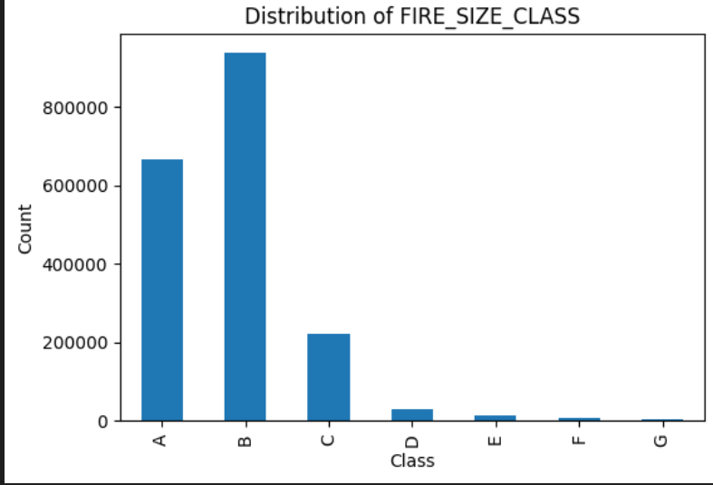
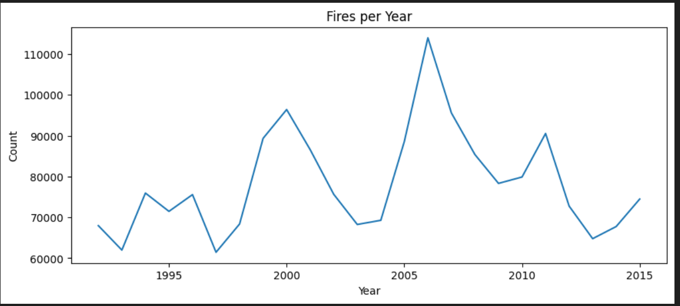
EDA

Slide 10
Pre-processing
• Missing values handled
• Label encoding for categories
• Feature engineering (Geo_clusters)
• Temporal Extraction:
  Turned raw Julian Dates into repeating time features like Month, Day of the Week, and Season. This helps show how people act and how weather changes throughout the year.
Spatial Clustering
  Problem: Latitude and longitude are smooth numbers that make it hard for trees to split data effectively.
  Solution: We used K-Means with 30 clusters to group the coordinates into separate "Geo-Clusters" (biomes), turning location into a category-based region.

Slide 11
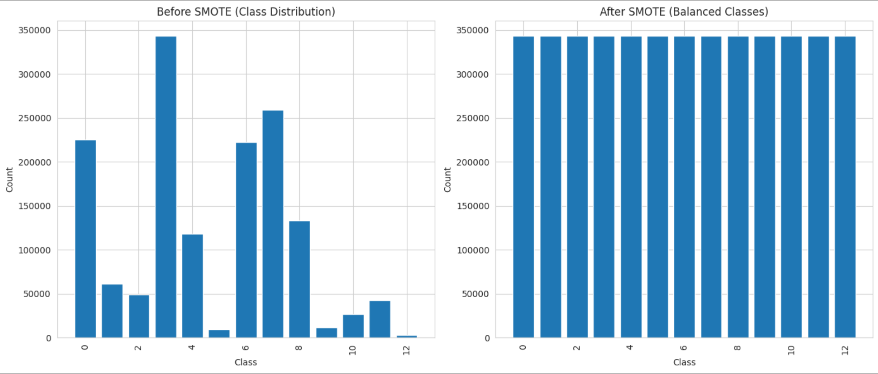
Handling Imbalance
  Applied SMOTE, which is a method for creating extra examples of the less common classes, like Fireworks, to make sure the model pays attention to them instead of focusing only on the more common ones.

Slide 12
Model used
XG Boost is a powerful machine learning model that uses trees to make predictions.
It is known for being fast, able to handle big data sets well, and providing accurate results.
It works especially well with structured data, such as the US Wildfire dataset.
XGBoost can manage different types of data, including non-linear patterns and complex relationships between features.

Slide 13
Hyperparameter Optimization
  RandomizedSearchCV:
    I used Randomized Search for 5 iterations to explore the hyperparameter space efficiently, which saves computational resources compared to Grid Search.
    Key Parameters Tuned:
    learning_rate [0.01 - 0.2]: Determines how quickly the model makes changes.
    max_depth [4 - 10]: Sets how deep the trees can grow, which helps avoid making the model too complex.
    n_estimators [100 - 300]: Tells how many trees will be used in the forest.

Slide 14

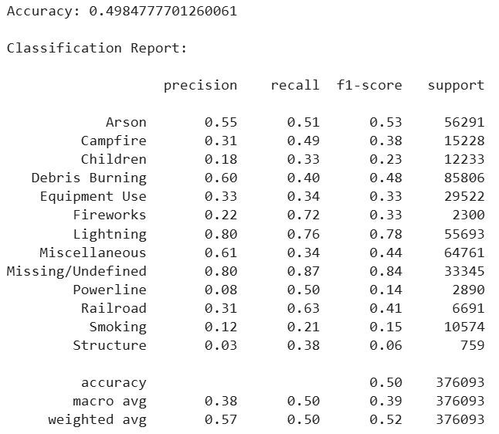
Evaluation & Results
Performance Context:
  Baseline Accuracy: about 7.7% (which is like guessing correctly once out of 13 times).
  Model Accuracy: about 40%.
  Although 40% seems not very high, it's 5 times better than just guessing, showing that spatiotemporal metadata has a strong ability to predict outcomes.
Class-Specific Performance
  Lightning (F1: 0.78): It is very predictable because it mostly happens in certain seasons and specific places.
  Human Causes (F1: ~0.30): There is a lot of confusion between "Arson", "Debris Burning", and "Campfires" since they often happen in the same areas and at similar times.

Slide 15
Critical Analysis
  Strengths
    Geo-Clustering has proven to be the most useful feature, as it turns coordinates into "Biomes".
    The system also shows great scalability, handling almost 2 million records efficiently thanks to GPU acceleration.
  Limitations
    The model doesn't have information about the weather on the day of the fire, like whether it was hot, dry, or windy. This is the main problem that affects how accurate the model is. Also, the target variable has labels like "Miscellaneous" and "Missing," which make it harder for the model to learn properly.

Slide 16
Summary and conclusions
The "5x Baseline" Validation
  Getting 40% accuracy compared to a 7% chance happening by luck shows that wildfires don't just happen by accident. There are clear patterns in where and when they occur, and Machine Learning can find these patterns.
The Human vs. Nature Divide
  The model is really good at predicting natural causes like lightning but has trouble telling the difference between human causes, such as arson and smoking, because they have the same location and time patterns.
The Accuracy Ceiling
  We hit a tough limit in performance just using metadata. Without knowing things like wind speed or humidity, the model can't tell the difference between a mistake that caused a fire and someone on purpose setting a fire.
Operational Viability
  This model isn't meant to replace a full forensic investigation, but it's a strong tool for quickly sorting through cases. It can quickly identify fires that are very likely to be caused by lightning, helping investigators save time.

Slide 17
References
1.88 Million US Wildfires:
https://www.kaggle.com/datasets/rtatman/188-million-us-wildfires
Analyzing 24 years of wildfire data in the US:
https://greghcam.medium.com/analyzing-25-years-of-wildfire-data-in-the-us-b3dd4ef7ec26
Physical, social, and biological attributes for improved understanding and prediction of wildfires: FPA FOD-Attributes dataset:
https://essd.copernicus.org/articles/16/3045/2024/
al-Bashiti, Mohammad & Naser, M.Z.. (2022). Machine learning for wildfire classification: Exploring blackbox, eXplainable, symbolic, and SMOTE methods. Natural Hazards Research. 2. 10.1016/j.nhres.2022.08.001.

Slide 18
                Thank you

